Slide 1
Spark & Databricks
Giulio Melloni

Slide 2
Big Data
…are they really big?
it depends….

Slide 3
What is your Big Data definition?

Slide 4


Slide 5
What?

Slide 6

ChatGPT Time

Slide 7
“Big Data refers to extremely large and complex data sets that are difficult to process and analyze using traditional data processing tools and techniques. These data sets typically involve large volumes of structured and unstructured data, such as social media feeds, sensor data, web logs, customer data, and financial transactions.
Big Data is characterized by its volume, velocity, variety, and veracity. The volume of Big Data refers to the massive amounts of data generated and collected from various sources. The velocity of Big Data refers to the speed at which the data is generated and needs to be processed. The variety of Big Data refers to the different types and formats of data, such as text, images, audio, and video. The veracity of Big Data refers to the quality and accuracy of the data.
Big Data is becoming increasingly important in today's world as organizations try to extract insights and value from the vast amounts of data available to them. Big Data analytics involves using advanced technologies such as machine learning, data mining, and natural language processing to extract insights and patterns from Big Data sets.”

Slide 8
Who?

Slide 9
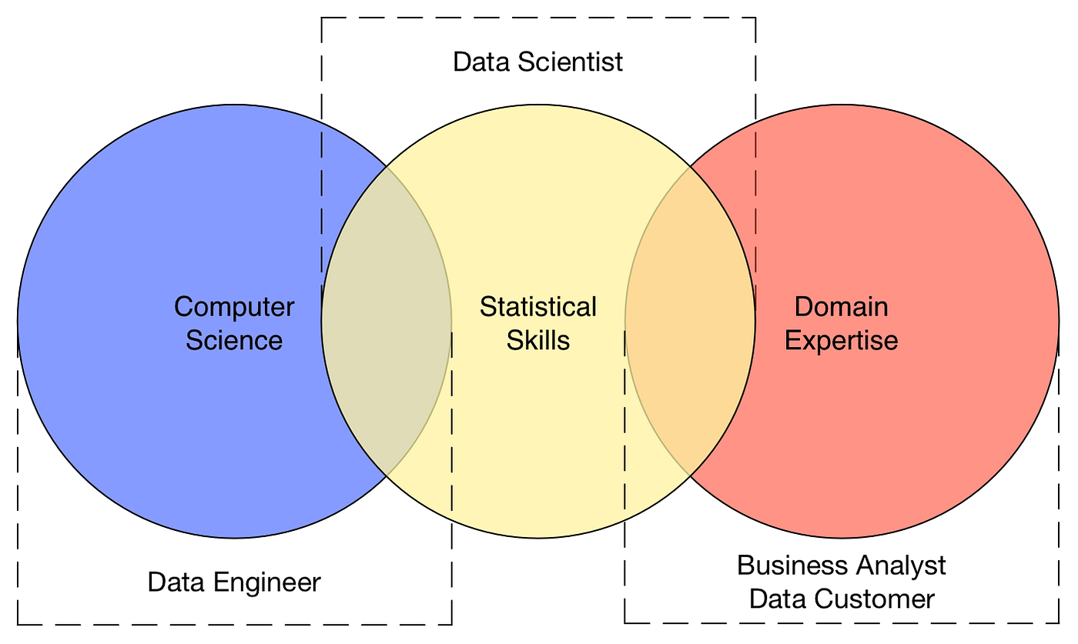
3 jobs to rule them all

Slide 10
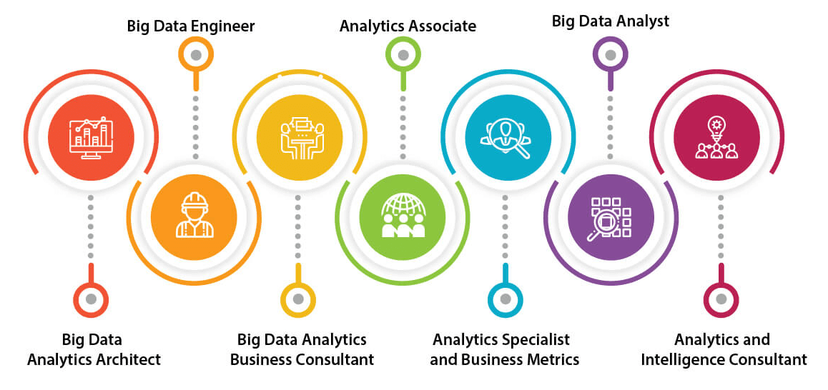
Sorry, I was wrong 7 jobs

Slide 11
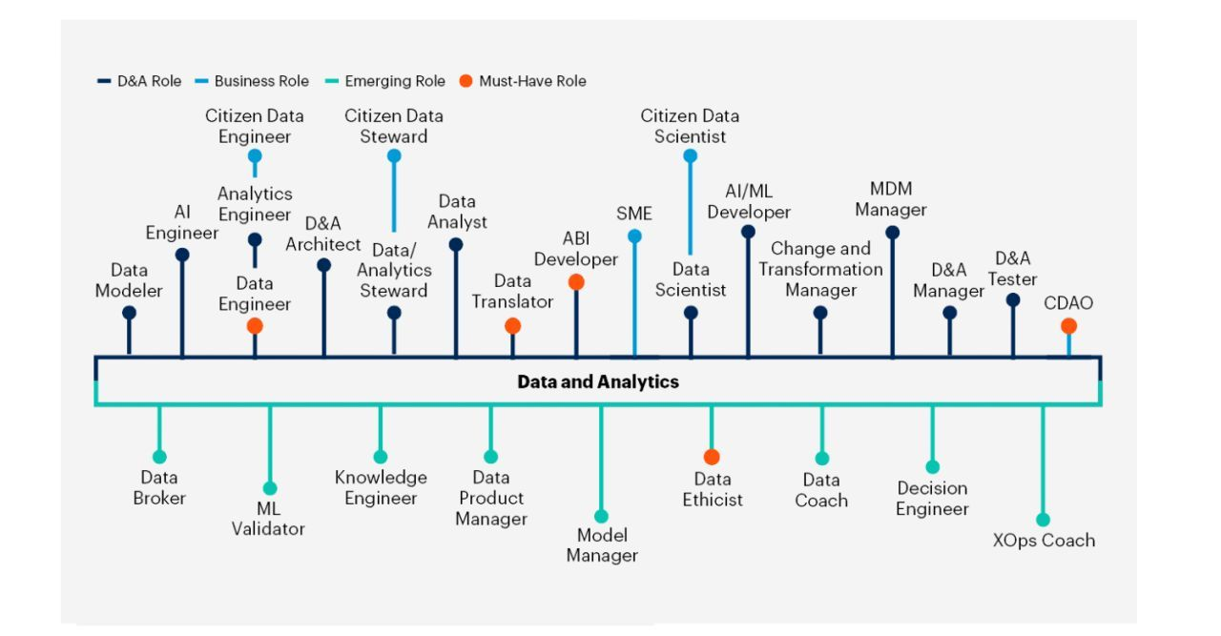

Well, I don’t know

Slide 12
When?

Slide 13



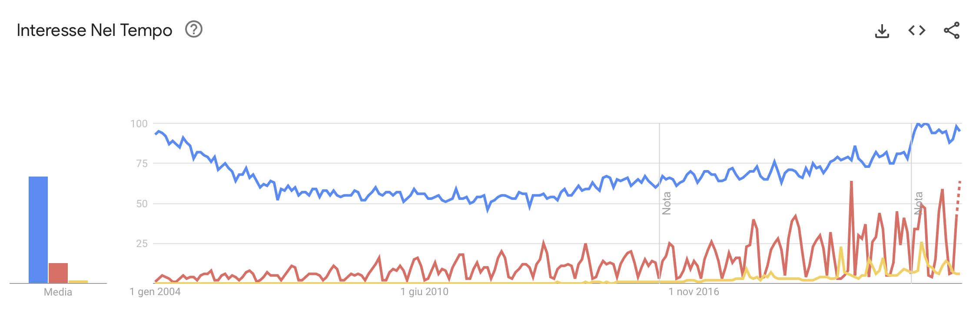

Slide 14
Where?

Slide 15
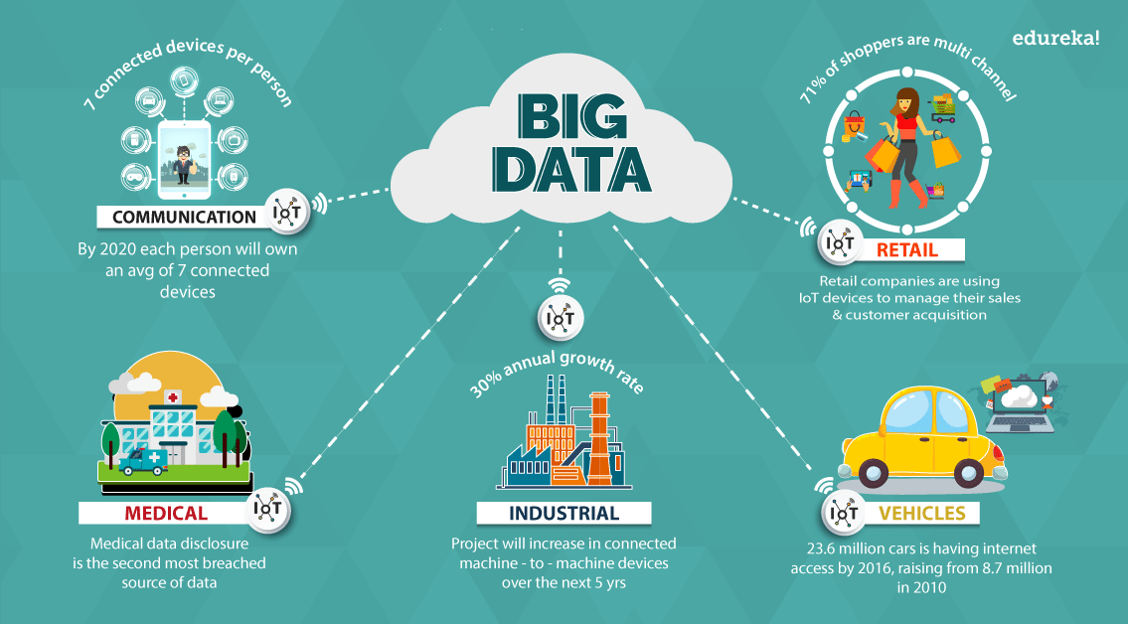

Slide 16
Why?

Slide 17
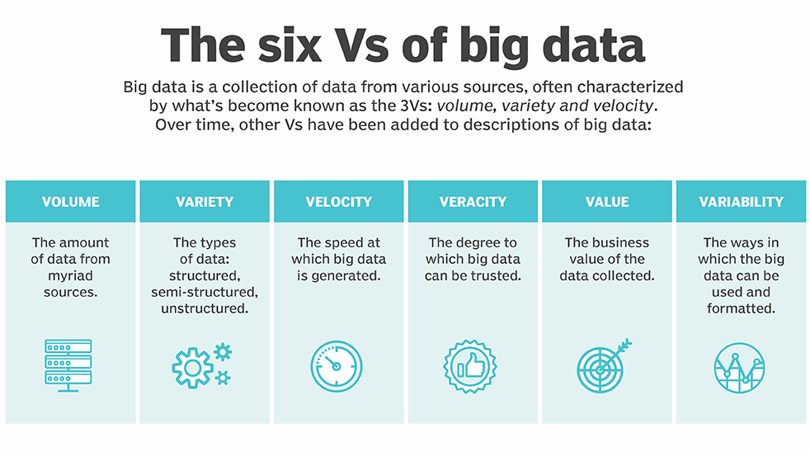

Slide 18


Slide 19


Slide 20
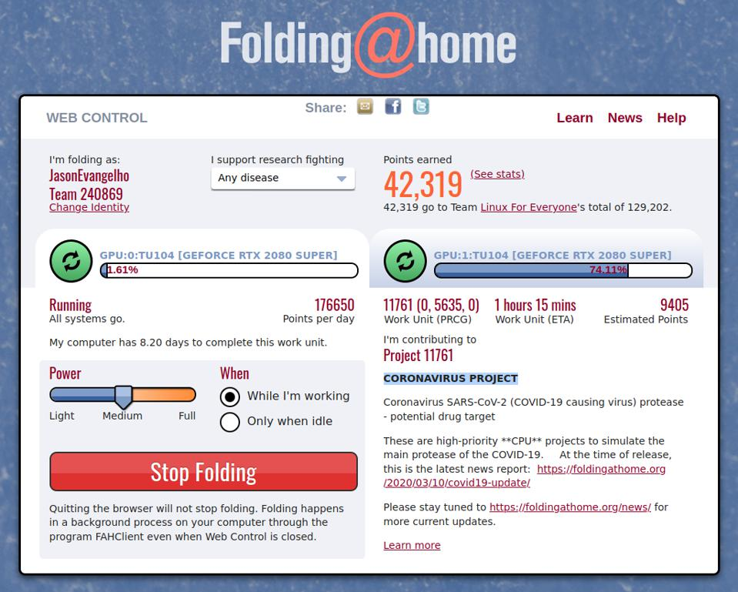
Forbes

Slide 21
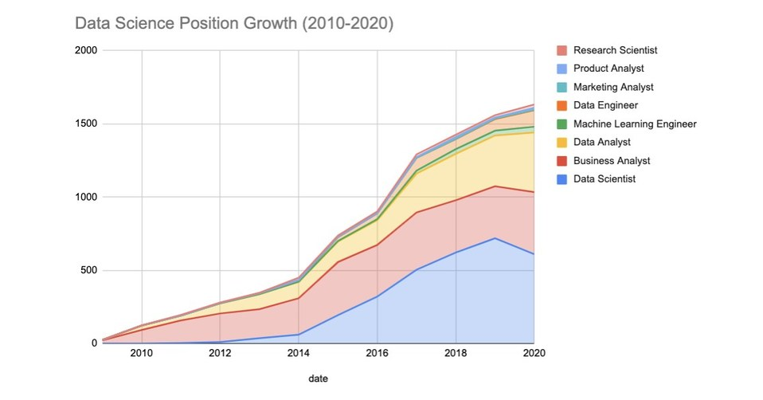
Work to live

Slide 22
How?

Slide 23
The Filtering Big Data problem

Slide 24


Slide 25
Open it
d&b
d&b
d&b
d&b
d&b
d&b
d&b
d&b
d&b
d&b
d&b
d&b
d&b
d&b
d&b
d&b

Slide 26
Can you eat all the brown D&Bs...
d&b
d&b
d&b
d&b
d&b
d&b
d&b
d&b
d&b
d&b
d&b
d&b
d&b
d&b
d&b
d&b

Slide 27

…in only 60 seconds?
60

Slide 28

…and what about a bag of D&B?

Slide 29
The Spark solution

Slide 30


Where do we start?

Slide 31
Let’s assume that:
each student can grab, open, and process one and only one small bag at a time

Slide 32
First subdivide the large bag of D&Bs into, smaller, more manageable bags

Slide 33
5
6
13
14
15
7
8
16
1
Assign each bag a unique number (or ID)
2
3
4
9
10
11
12

Slide 34
























Assign each student a unique letter, or ID

Slide 35
Student A gets bag #2...
Student B gets bag #3...
Student C gets bag #6...
and so on...

Slide 36
Instructions: Eat all the brown D&Bs and pile the rest in the corner.

Slide 37
Ready…
Set…
Go!

Slide 38
Some students are faster than others…
And yet others are a slower than the some...
d&b
d&b
d&b
d&b
d&b
d&b
d&b
d&b
d&b
d&b
d&b
d&b
d&b
d&b
d&b
d&b
d&b
d&b
d&b
d&b

Slide 39
…everybody just works at their own pace…
d&b
d&b
d&b
d&b
d&b
d&b
d&b
d&b
d&b
d&b
d&b
d&b
d&b
d&b
d&b
d&b
d&b
d&b
d&b
d&b
d&b
d&b
d&b
d&b
d&b
d&b
d&b
d&b
d&b
d&b
d&b
d&b
d&b
d&b
d&b
d&b
d&b
d&b
d&b
d&b
d&b
d&b
d&b
d&b
d&b
d&b
d&b
d&b
d&b
d&b
d&b
d&b
d&b
d&b
d&b
d&b
d&b
d&b
d&b
d&b
d&b
d&b
d&b
d&b
d&b
d&b
d&b
d&b
d&b
d&b
d&b
d&b
d&b
d&b
d&b

Slide 40
4 of our students
are idle again…
d&b
d&b
d&b
d&b
d&b
d&b
d&b
d&b
d&b
d&b
d&b
d&b
d&b
d&b
d&b
d&b
d&b
d&b
d&b
d&b
d&b
d&b
d&b
d&b
d&b
d&b
d&b
d&b
d&b
d&b
d&b
d&b
d&b
d&b
d&b
d&b
d&b
d&b
d&b
d&b
d&b
d&b
d&b
d&b
d&b
d&b
d&b
d&b
d&b
d&b
d&b
d&b
d&b
d&b
d&b

Slide 41
5
8
They need new tasks!
1
Students A, E, H, & J, grab bags #1, #4, #5, & #8
d&b
d&b
d&b
d&b
d&b
4
d&b
d&b
d&b
d&b
d&b
d&b
d&b
d&b
d&b
d&b
d&b
d&b
d&b
d&b
d&b
d&b
d&b
d&b
d&b
d&b
d&b
d&b
d&b
d&b
d&b
d&b
d&b
d&b
d&b
d&b
d&b
d&b
d&b
d&b
d&b
d&b
d&b
d&b
d&b
d&b
d&b
d&b
d&b
d&b
d&b
d&b
d&b
d&b
d&b
d&b

Slide 42
And so they just keep working…
…and working…
d&b
d&b
d&b
d&b
d&b
d&b
d&b
d&b
d&b
d&b
d&b
d&b
d&b
d&b
d&b
d&b
d&b
d&b
d&b
d&b
d&b
d&b
d&b
d&b
d&b
d&b
d&b
d&b
d&b
d&b
d&b
d&b
d&b
d&b
d&b
d&b
d&b
d&b
d&b
d&b
d&b
d&b
d&b
d&b
d&b
d&b
d&b
d&b
d&b
d&b
d&b
d&b
d&b
d&b
d&b
d&b
d&b
d&b
d&b
d&b
d&b
d&b
d&b
d&b
d&b
d&b
d&b
d&b
d&b
d&b
d&b
d&b
d&b
d&b
d&b
d&b
d&b
d&b
d&b
d&b
d&b
d&b
d&b
d&b
d&b
d&b
d&b
d&b
d&b
d&b
d&b
d&b
d&b
d&b
d&b
d&b
d&b
d&b
d&b
d&b

Slide 43
…and working…
d&b
d&b
d&b
All Done!
d&b
d&b
d&b
d&b
d&b
d&b
d&b
d&b
d&b
d&b
d&b
d&b
d&b
d&b
d&b
d&b
d&b
d&b
d&b
d&b
d&b
d&b
d&b
d&b
d&b
d&b
d&b
d&b
d&b
d&b
d&b
d&b
d&b
d&b
d&b
d&b
d&b
d&b
d&b
d&b
d&b
d&b
d&b
d&b
d&b
d&b
d&b
d&b
d&b
d&b
d&b
d&b
d&b
d&b
d&b
d&b
d&b
d&b
d&b
d&b
d&b
d&b
d&b
d&b
d&b
d&b
d&b
d&b
d&b
d&b
d&b
d&b
d&b
d&b
d&b
d&b
d&b
d&b
d&b
d&b
d&b
d&b
d&b
d&b
d&b
d&b
d&b
d&b
d&b
d&b
d&b
d&b
d&b
d&b
d&b
d&b
d&b

Slide 44


Slide 45
Spark Architecture Concepts
First subdivide the large bag of D&Bs into, smaller, more manageable bags
Driver? Executors? Cluster? Thread? Parallelization? Partition? Job? Task?

Slide 46
Let’s use the right dictionary

Slide 47
Driver
d&b
d&b
d&b
d&b
d&b
d&b
d&b
d&b
d&b
d&b
d&b
d&b
d&b
d&b
d&b
d&b
d&b
d&b
d&b
d&b

Slide 48
Driver
Executors
d&b
d&b
d&b
d&b
d&b
d&b
d&b
d&b
d&b
d&b
d&b
d&b
d&b
d&b
d&b
d&b
d&b
d&b
d&b
d&b

Slide 49
Spark Cluster
Driver
Executors
d&b
d&b
d&b
d&b
d&b
d&b
d&b
d&b
d&b
d&b
F
d&b
d&b
d&b
d&b
d&b
d&b
d&b
d&b
d&b
d&b
I

Slide 50
Spark Cluster
Nodes
d&b
d&b
d&b
d&b
d&b
d&b
d&b
d&b
d&b
d&b
d&b
d&b
d&b
d&b
d&b
d&b
d&b
d&b
d&b
d&b

Slide 51
Nodes
d&b
d&b
d&b
d&b
d&b
Slots / Threads / Cores
(interchangeable terms)
d&b
d&b
d&b
d&b
d&b

Slide 52
Nodes
d&b
d&b
d&b
d&b
d&b
Shared Resources
(RAM, Disk, Network)
d&b
d&b
d&b
d&b
d&b

Slide 53
Maximum Parallelization: 12 Tasks
(6 executors, 2 cores each)
d&b
d&b
d&b
d&b
d&b
d&b
d&b
d&b
d&b
d&b
d&b
d&b
d&b
d&b
d&b
d&b
d&b
d&b
d&b
d&b

Slide 54
Dataset
d&b
d&b
d&b
d&b
d&b
d&b
d&b
d&b
d&b
d&b
d&b
d&b
d&b
d&b
d&b
d&b
d&b
d&b
d&b
d&b

Slide 55
Partitions
d&b
d&b
d&b
d&b
d&b
d&b
d&b
d&b
d&b
d&b
d&b
d&b
d&b
d&b
d&b
d&b
d&b
d&b
d&b
d&b

Slide 56
Instructions: Eliminate all the brown candies and pile the rest in the corner.
A Spark Job
(with only 1 stage)
d&b
d&b
d&b
d&b
d&b
d&b
d&b
d&b
d&b
d&b
d&b
d&b
d&b
d&b
d&b
d&b
d&b
d&b
d&b
d&b

Slide 57
Quick review

Slide 58
Cluster & Nodes
A Cluster is a group of nodes
Nodes are the individual machines within a cluster (generally a VM)

Slide 59
Driver
Runs the Spark application
Assigns tasks to slots in an executor
Coordinates the work between tasks
Receives the results, if any

Slide 60
Executors
Provides an environment in which tasks can be run
Leverages the JVM to execute many threads

Slide 61
Slots / Cores / Threads
The lowest unit of parallelization
Generally interchangeable terms, but “slot” is the most accurate term
Executes a set of transformations against a partition as directed to by the driver

Slide 62
Parallelization
Scale horizontally by adding more executors
Scale vertically by adding cores to each executor

Slide 63
Partitions
A ~128 MB chunk of the larger dataset
Each task processes one and only one partition
The size and record splits are decided by the driver
The initial size is partially adjustable with various configuration options

Slide 64
Applications, Jobs, Stage and Tasks
The hierarchy into which work is subdivided
One Spark action results in one or more jobs
The number of stages depends on the operations submitted with the application
Tasks are the smallest unit of work

Slide 65
Databricks

Slide 66
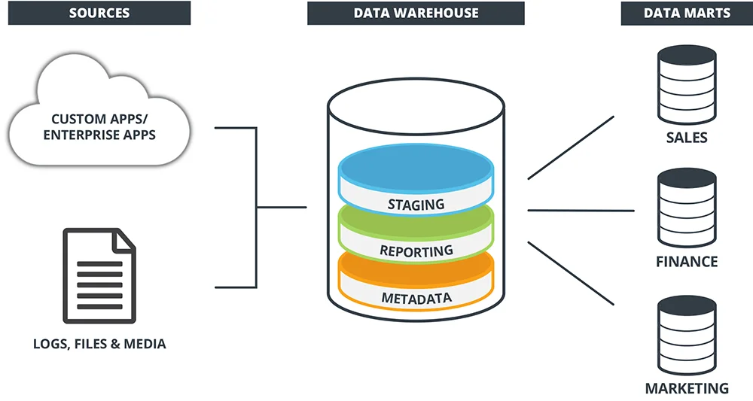
Data Warehouse

Slide 67
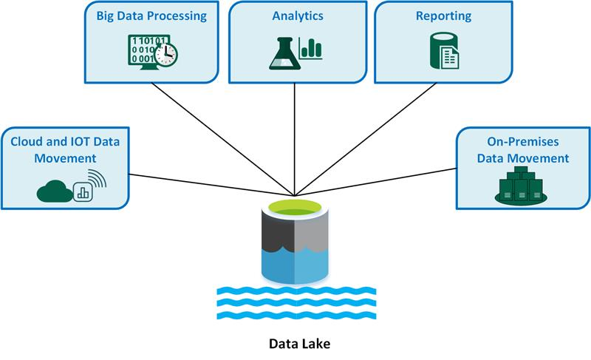
Data Lake

Slide 68
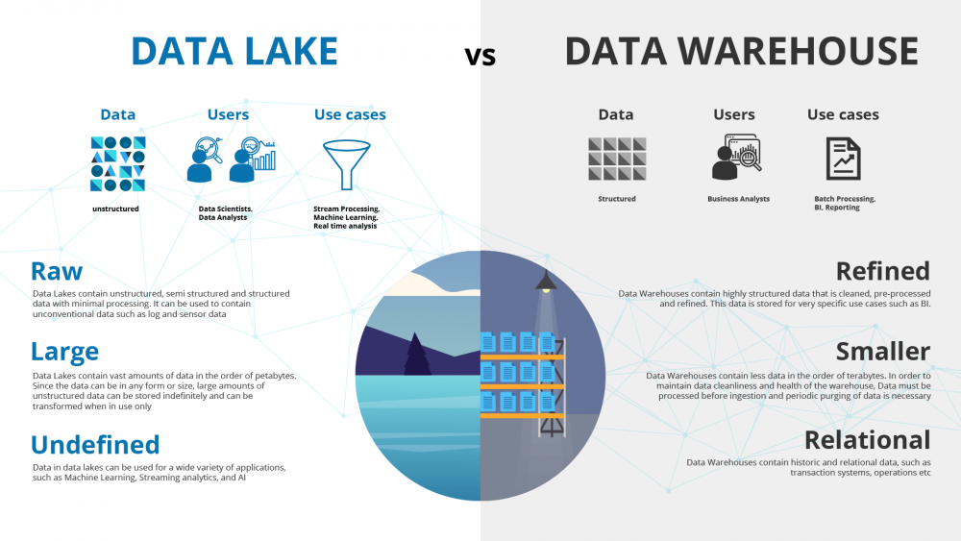
The final battle?

Slide 69
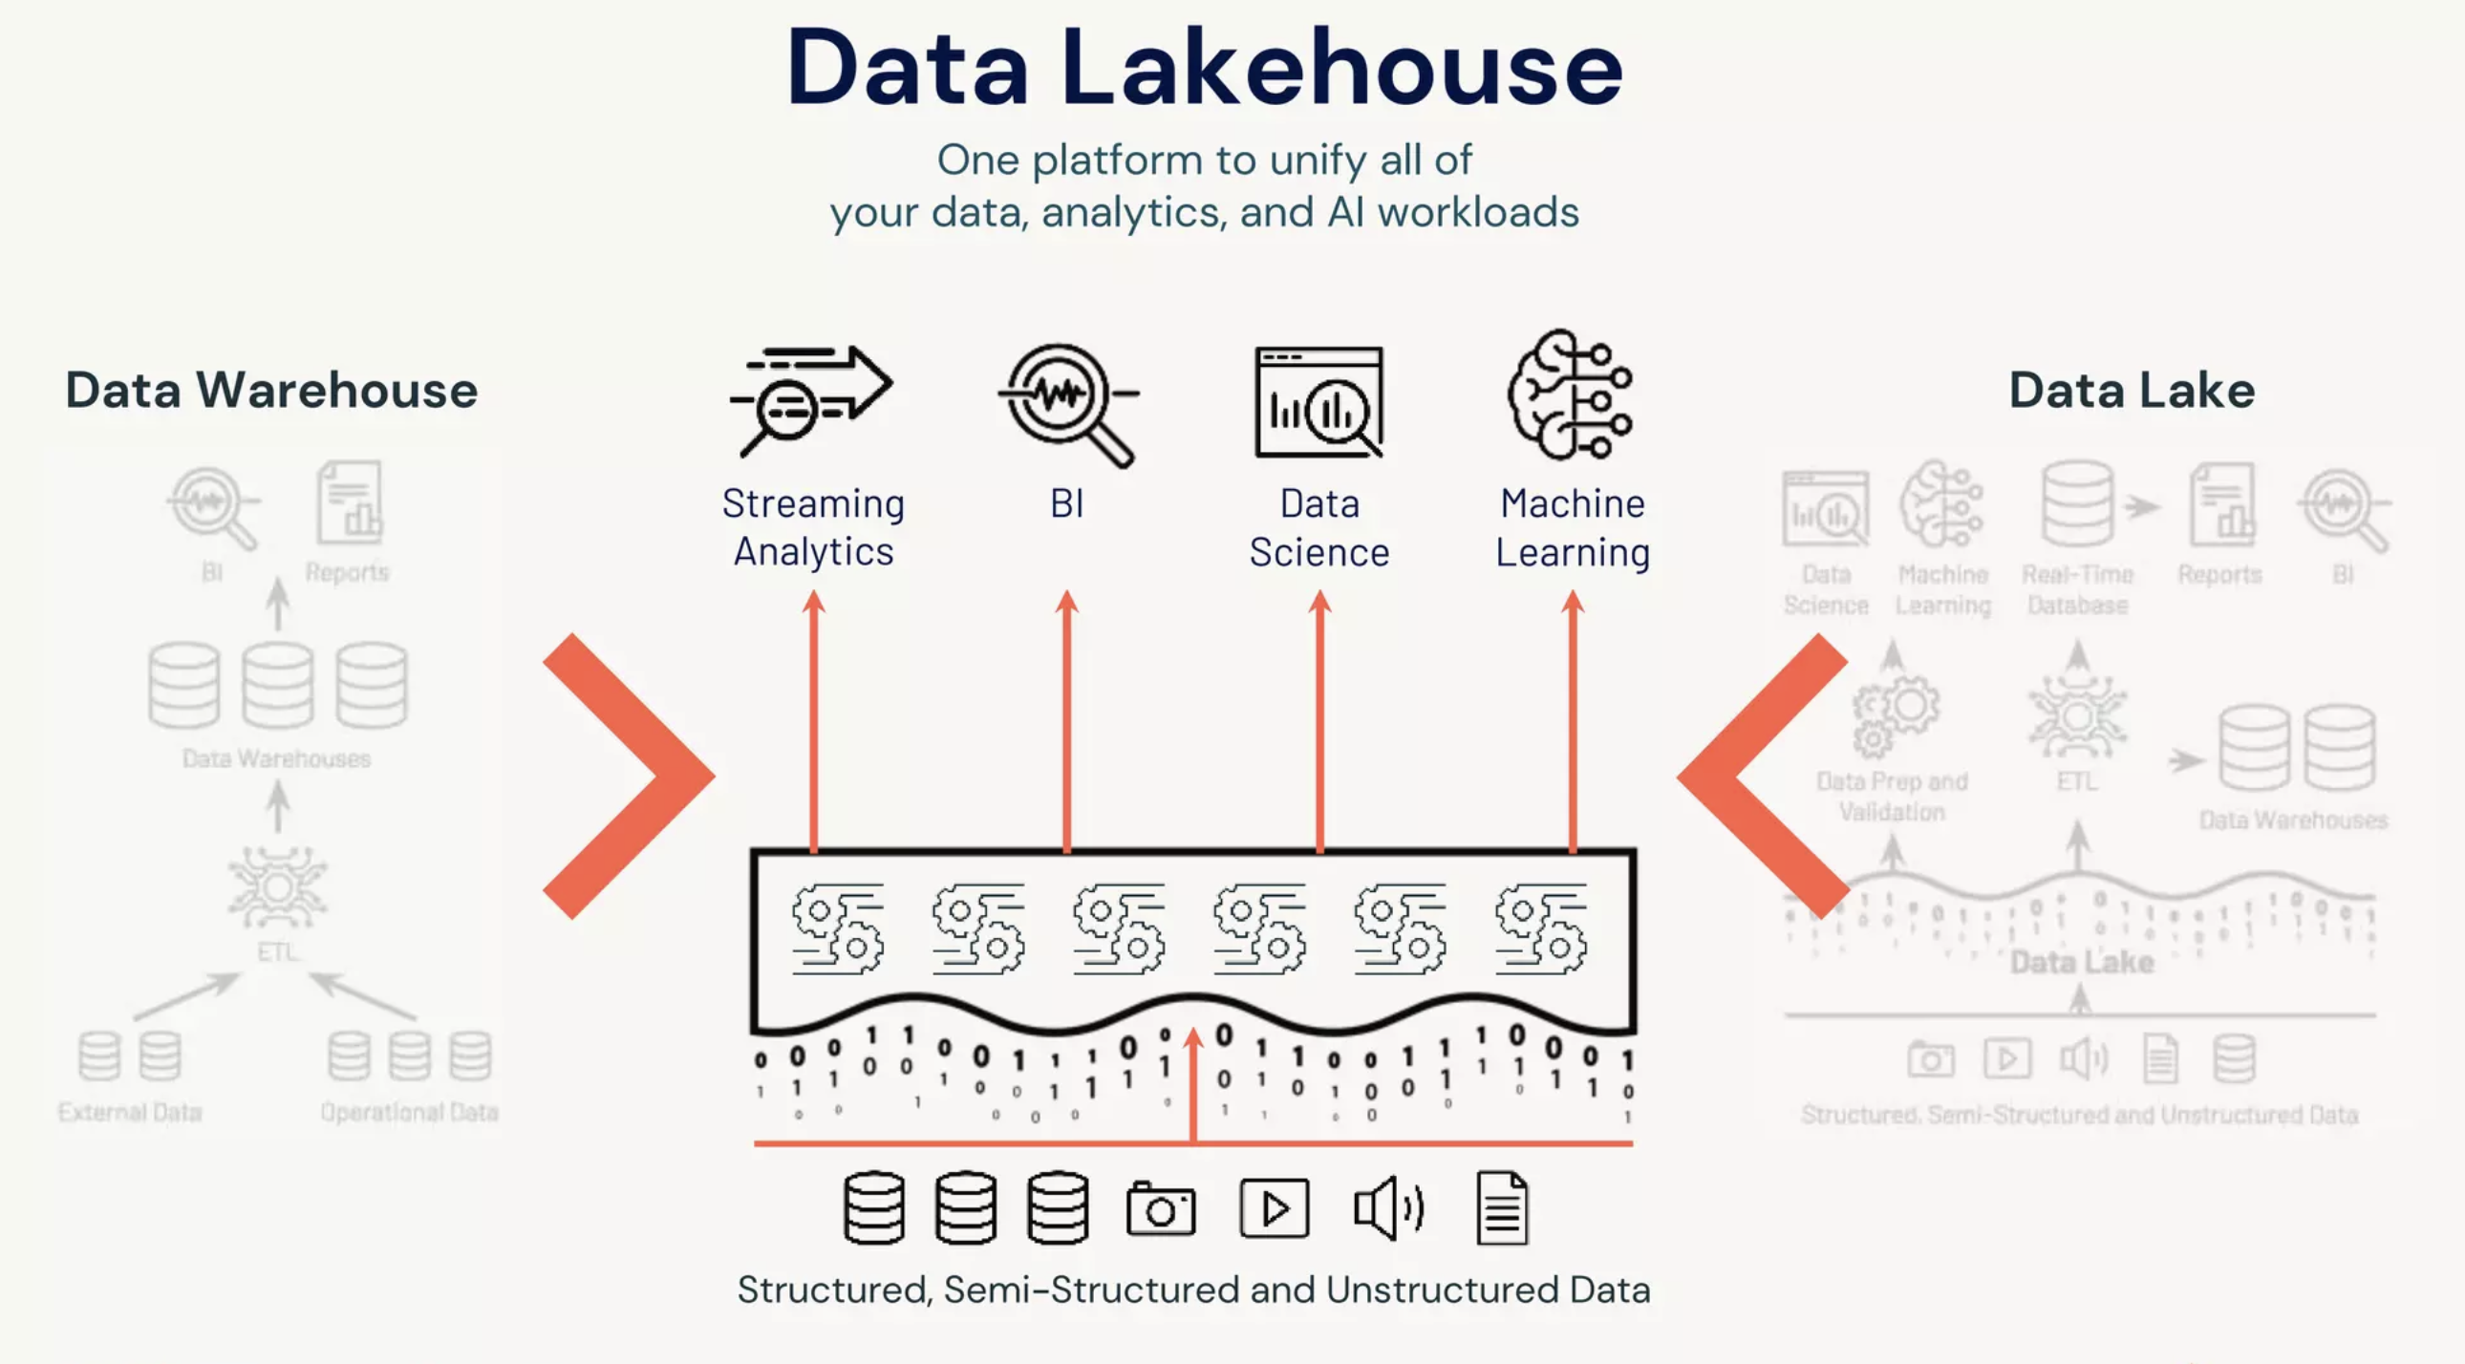

Slide 70
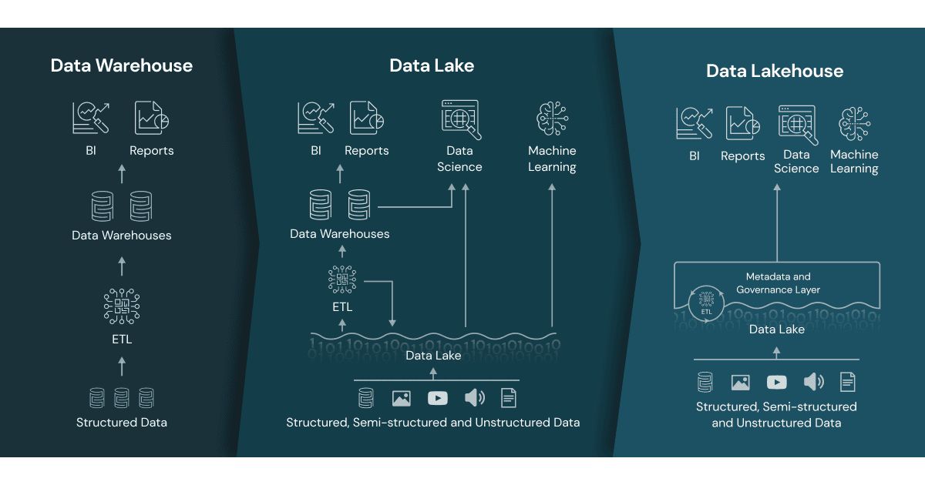
The perfect combination

Slide 71
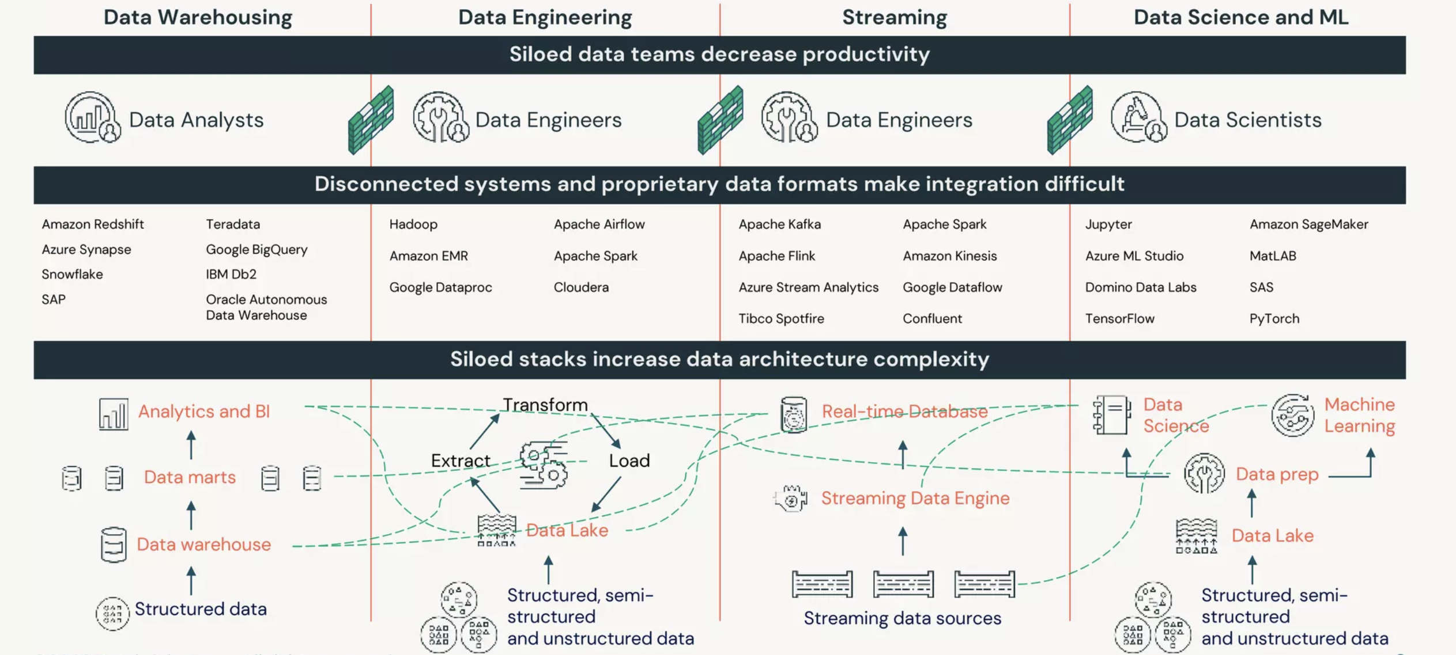
Everything in one place

Slide 72
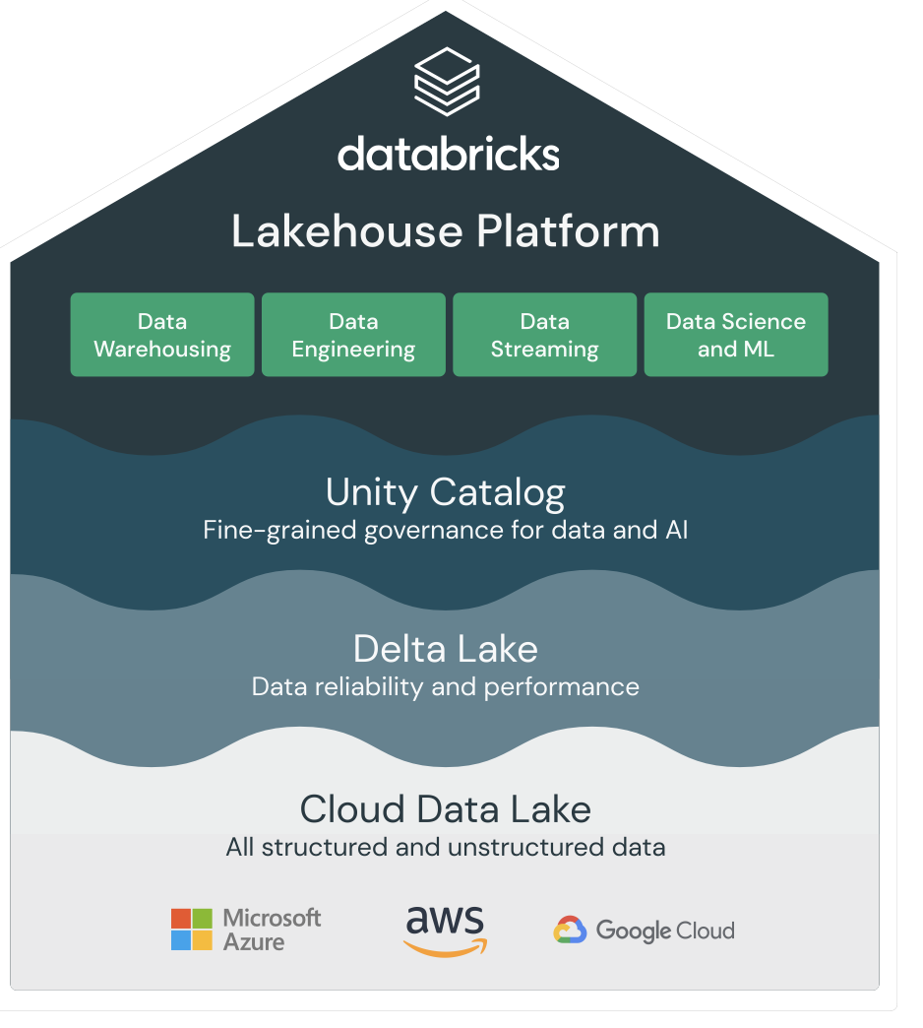
Architecture

Slide 73
Clusters

Slide 74
Key Points
Scalability
Databricks Clusters can scale up or down based on the workload requirements. This flexibility ensures that you have the right number of computational resources for your tasks, whether you’re running small ad-hoc queries or large-scale data processing jobs.
Optimized Performance
Clusters in Databricks are optimized for performance, leveraging the power of Apache Spark. This allows for efficient processing of large datasets, making it suitable for various data-intensive tasks like ETL, machine learning, and streaming analytics.
Ease of Management
Databricks provides a user-friendly interface for creating, managing, and monitoring clusters. You can easily configure clusters with different settings and automatically terminate them when not in use to save costs.
Integration with Databricks Ecosystem
Clusters are seamlessly integrated with other Databricks services, such as Delta Lake, MLflow, and Unity Catalog. This integration enhances the overall functionality and usability of the Databricks platform.

Slide 75
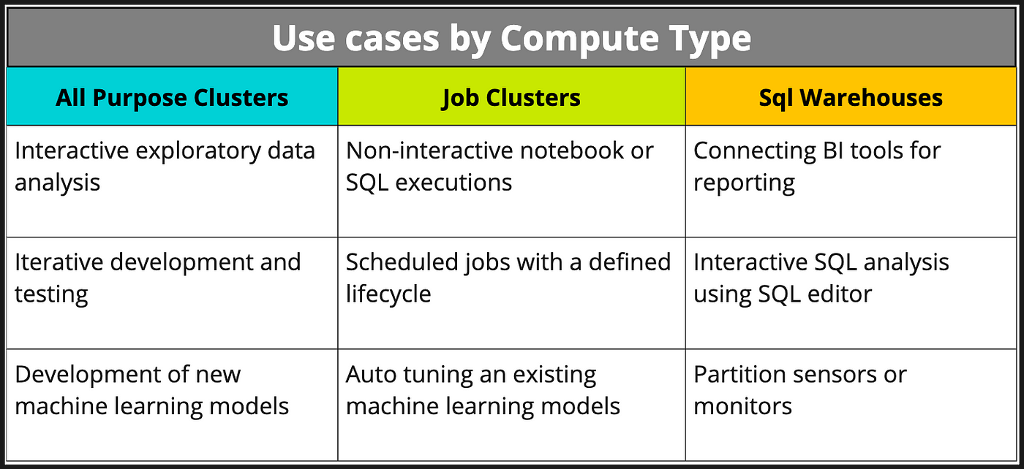
Cluster types

Slide 76
Lab: Manage a Cluster

Slide 77
Data Lake vs Data Warehouse

Slide 78
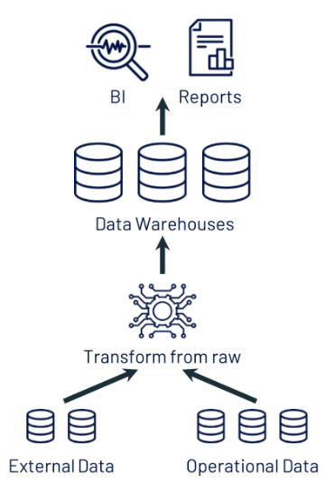
What is a Data Warehouse?
Used for BI and Reporting
Meant to integrate together different source systems
Can store only Structured Data
Not efficient for Data Science and Streaming

Slide 79
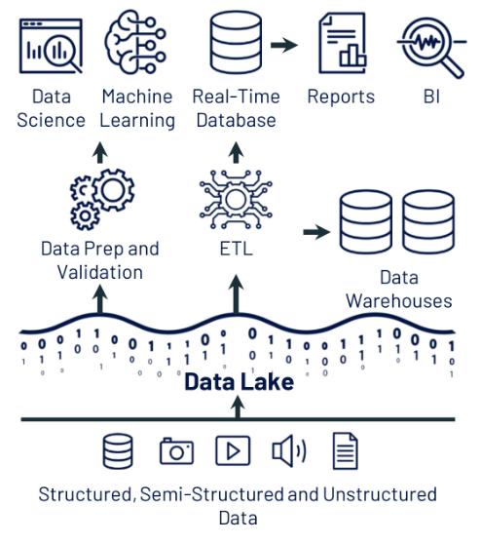
What is a Data Lake?
Centralized repository that ingests data in the original form
It can store any type of data: Non-Structured, Semi Structured or Structured
Often used to store data that will be transformed using ETL pipelines to be ingested in Data Warehouses
Typically used for Data Science purposes purposes

Slide 80
Data Lake + Data Warehouse

Slide 81

How to achieve Data Lakehouse?
Delta Tables are an evolution of the Parquet File
ACID Compliant
Track metadata
Robust Data Store
Disegned to work with Spark
Time Travel

Slide 82
Lab: Create Delta Tables

Slide 83
Notebooks

Slide 84
What are Notebooks?
Primary toolfor developing code and presenting results
Users can write code and send it to the Clusters and show immediatly the results
Supports Real Time Coauthoring
Supports multiple language, even inside a single notebook
Automatic Versioning
Built-in data visualizations
Completely in text format, versionable in git too

Slide 85
SQL

Slide 86
What is Databricks SQL?
Databricks relies on Spark, that have native SQL support
Using SQL Queries it is possible to interact with data, without deep knowledge of programming languages
Using SQL Editor and SQL Warehouse it is possible to interact with the data with a easier approach than the Notebooks
The output of the queries can be showed in different ways, like tables and graphs, and downloaded to local
Used queries can be saved like the notebooks
It is possible to create functions that use more sql queries in one

Slide 87
Lab: Query the Data

Slide 88
Medallion Architecture

Slide 89
Key Points
Overview of Medallion Architecture
Databricks Medallion Architecture is a layered data management framework that facilitates the organization and processing of data across various stages for optimal usability.
Objectives of the Model
The architecture aims to enhance data integration, improve data quality, and streamline analytics by categorizing data into distinct stages based on its readiness for analysis.
Importance in Data Lakes
This architecture supports the creation of a robust data lake, enabling diverse analytics capabilities and fostering collaboration across data­ driven teams .
Structural Framework
The Medallion Architecture consists of three primary layers - Bronze, Silver, and Gold - each responsible for specific data processing tasks essential for a comprehensive data strategy.

Slide 90
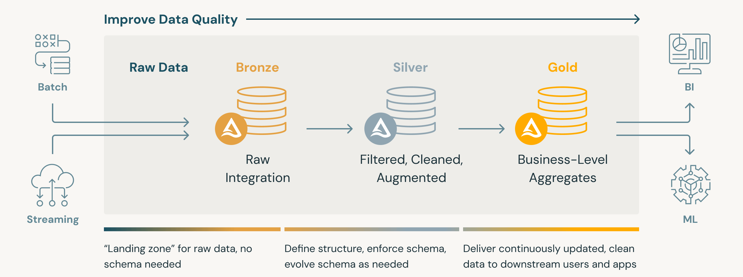
Medallion Architecture

Slide 91
Bronze Layer
Purpose of the Bronze Layer
This foundational layer serves to capture all incoming data, irrespective of its format , providing a secure repository for raw information that can later be processed.
Types of Data Ingested
Data entering the Bronze layer can be structured, semi-structured, or unstructured, including logs, JSON, CSV, and other formats from diverse sources.
Ingestion Techniques
Common techniques for data ingestion into the Bronze layer include batch processing, streaming, and event-driven architectures that accommodate real-time data influx.
Storage Solutions
Utilizing robust cloud storage solutions, such as Delta Lake, ensures efficient data storage with scalability and reliability for future processing needs.

Slide 92
Silver Layer
Objective of the Silver Layer
The Silver layer transforms raw data from the Bronze layer into a structured and cleansed state, enhancing data usability and quality for analysis.
Ensuring Data Quality
Quality assurance techniques are employed here to validate and sanitize data, eliminating inconsistencies and inaccuracies that may hinder later analysis.
Transformation Processes
Common transformations include data cleansing, normalization , deduplication , and enrichment to produce structured datasets that are analysis-ready.
Application Scenarios
This layer supports various use cases such as analytics preparation , reporting, and machine learning model training , ultimately leading to actionable insights.

Slide 93
Gold Layer
Role of the Gold Layer
The Gold layer serves as the final repository for processed and aggregated data, intended for high-level analytics and decision-making processes.
Advantages of aggregated data
Data aggregation in this layer provides comprehensive analytics insights, enabling organizations to make informed strategic decisions based on complete datasets
Aggregation techniques
Common techniques for data aggregation include summarization, statistical analysis, and visualizations that present datasets in an easily interpretable format for stakeholders.
Support for Business Intelligence and AI
The Gold layer is instrumental for feeding business intelligence tools, guiding organizations toward data-driven strategies and improving operational performance.

Slide 94
Lab: Create a Medallion Architecture

Slide 95
Workflows

Slide 96
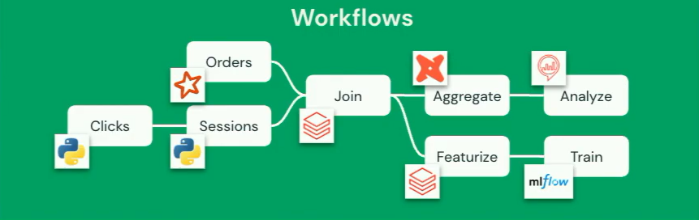
Orchestrating Databricks

Slide 97
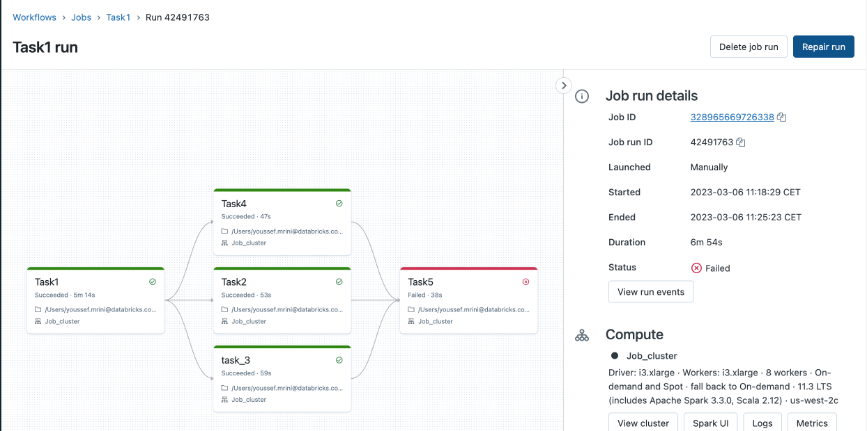
Databricks Workflow

Slide 98
Key Points
Unified Orchestration
Databricks Workflows allows you to define, manage, and monitor multi-task workflows for ETL (Extract, Transform, Load), analytics, and machine learning pipelines.
Wide Range of Supported Task Types
It supports various task types, including Spark, SQL, Python, and arbitrary code, making it versatile for different data processing needs.
Deep Observability
The platform provides extensive monitoring and observability capabilities, helping you track the performance and health of your workflows.
Control Flows
Conditional Logic and Control Flows: You can define dependencies and control flows between tasks, enabling complex data processing scenarios.

Slide 99
Lab: Orchestrate an ETL

Slide 100
Delta Live Tables

Slide 101
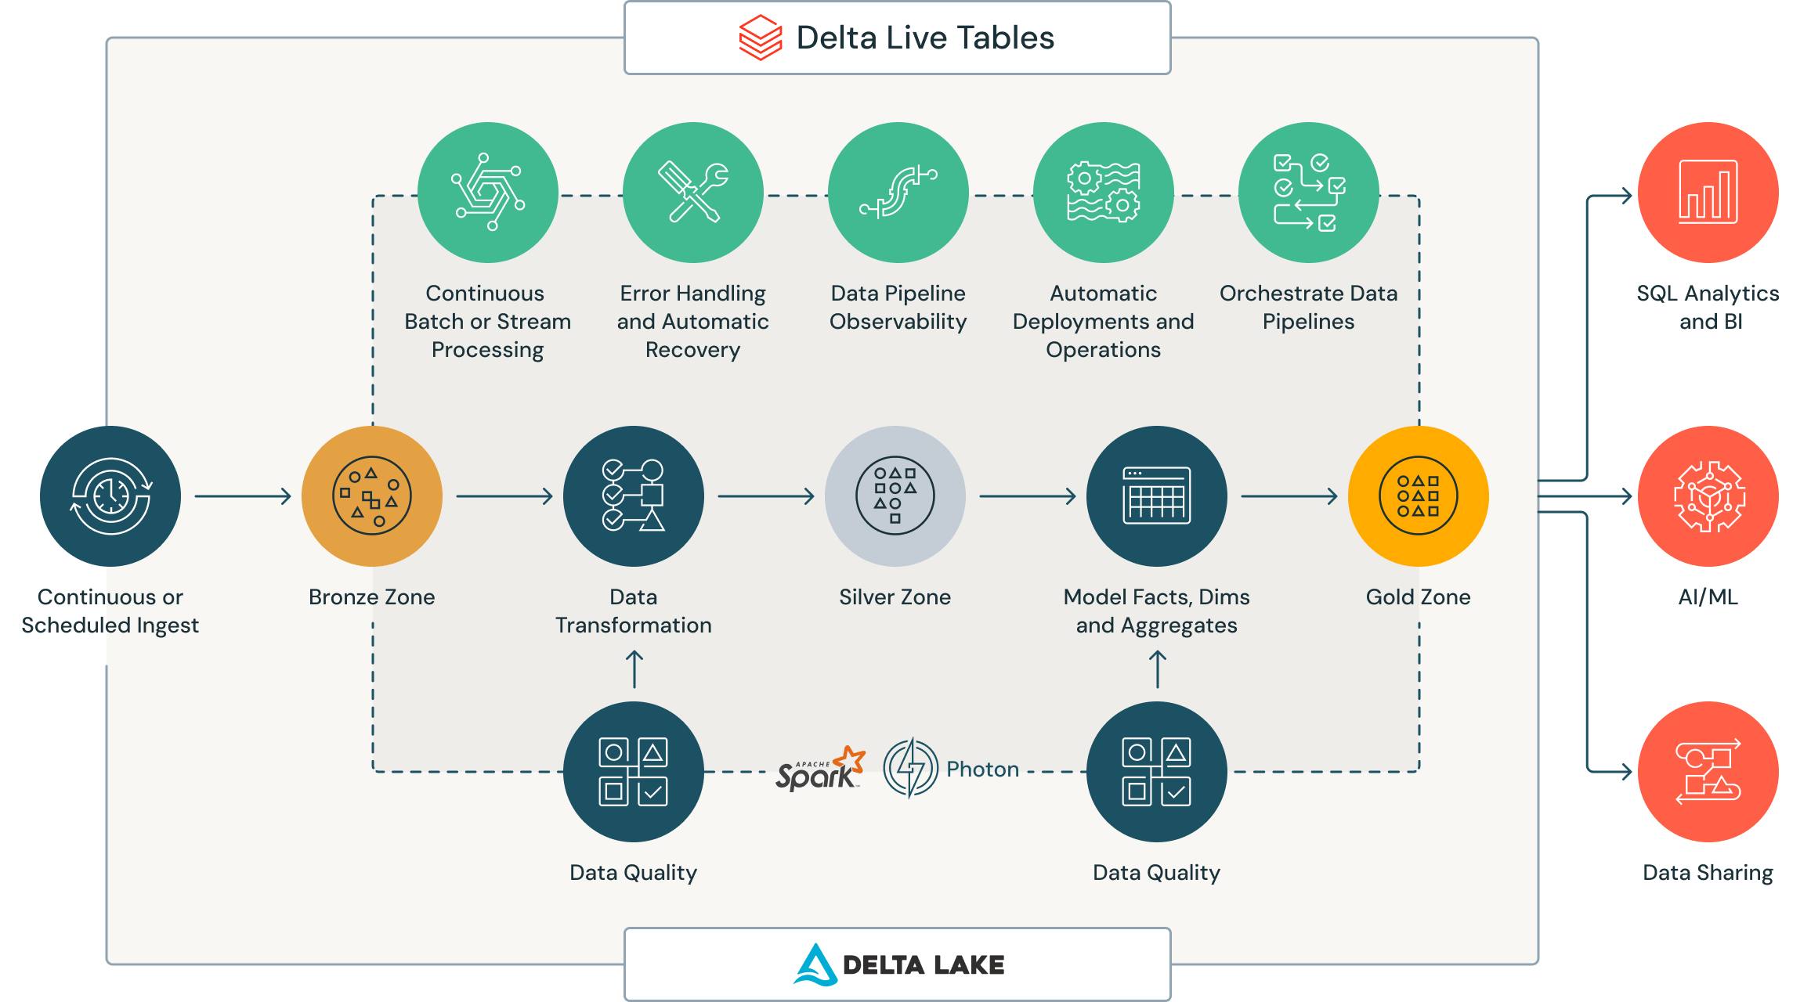
Data Quality

Slide 102
Key Points
Declarative Pipeline Development
Delta Live Tables (DLT) allows you to define data transformations using SQL or Python in a declarative manner. This means you specify what you want to achieve, and DLT handles the orchestration, cluster management, and execution.
Automatic Scaling and Management
DLT automatically scales to match your workload and manages the underlying infrastructure. This includes handling both batch and streaming data, ensuring efficient resource utilization and reducing operational overhead.
Built-In Data Quality Controls
DLT includes built-in data quality checks and error handling. You can define expectations for data quality, and DLT will enforce these rules, ensuring that only high-quality data is processed and stored.
Support for Streaming and Batch Processing
DLT supports both streaming and batch operations on the same tables. This flexibility allows you to process real-time data alongside historical data, making it easier to build comprehensive data pipelines.

Slide 103
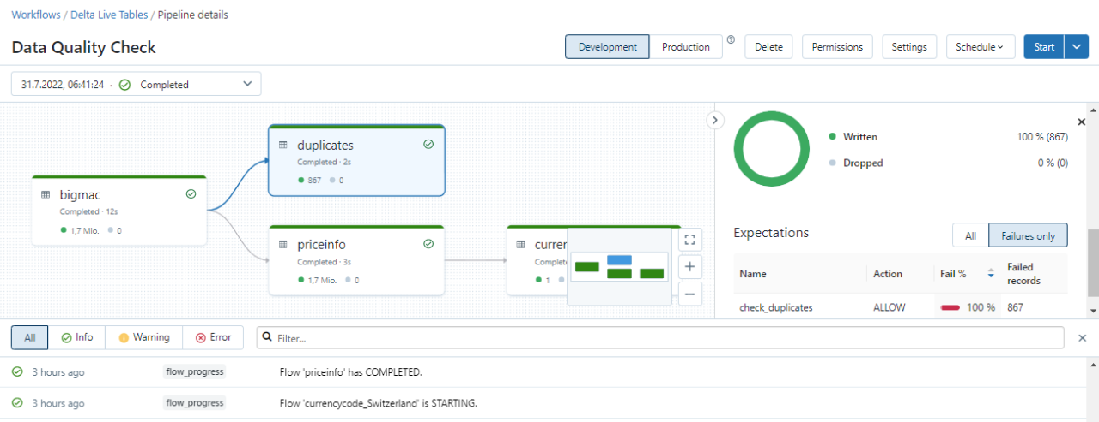
Workflows, again

Slide 104
Lab: Check Your Data

Slide 105
Unity Catalog

Slide 106
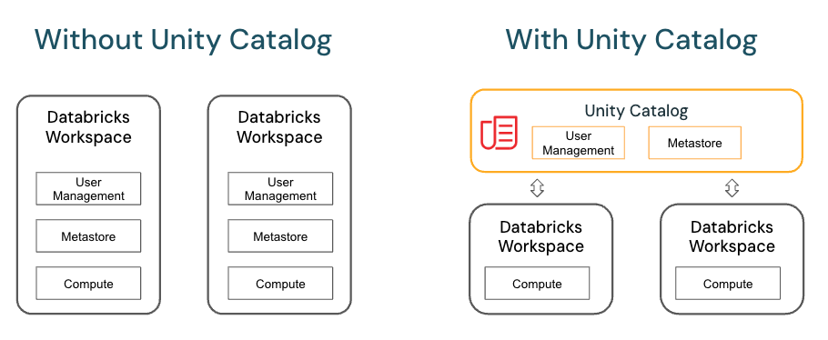
Without and With

Slide 107
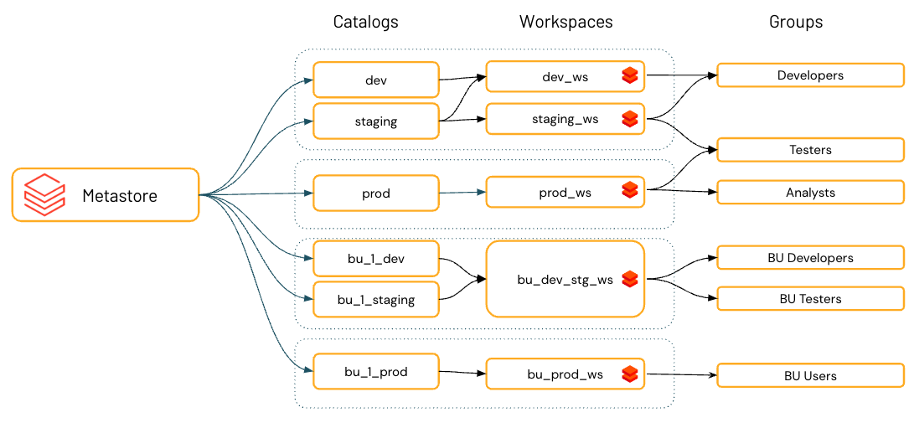
Organize Your Data

Slide 108
Key Points
Centralized Access Control
Unity Catalog provides a unified interface to manage data access policies across all Databricks workspaces, ensuring consistent and secure data governance.
Data Lineage
It automatically tracks and records data lineage, offering detailed insights into data transformations and usage, which is crucial for auditing and compliance.
Auditing and Logging
Built-in auditing capabilities capture comprehensive user-level audit logs, enabling thorough monitoring of data access and usage.
Data Discovery
Unity Catalog facilitates data discovery by allowing tagging and documentation of data assets, making it easier for users to find and understand the data they need.

Slide 109
Lab: Unity Catalog Walkthrough

Slide 110
Data Masking

Slide 111
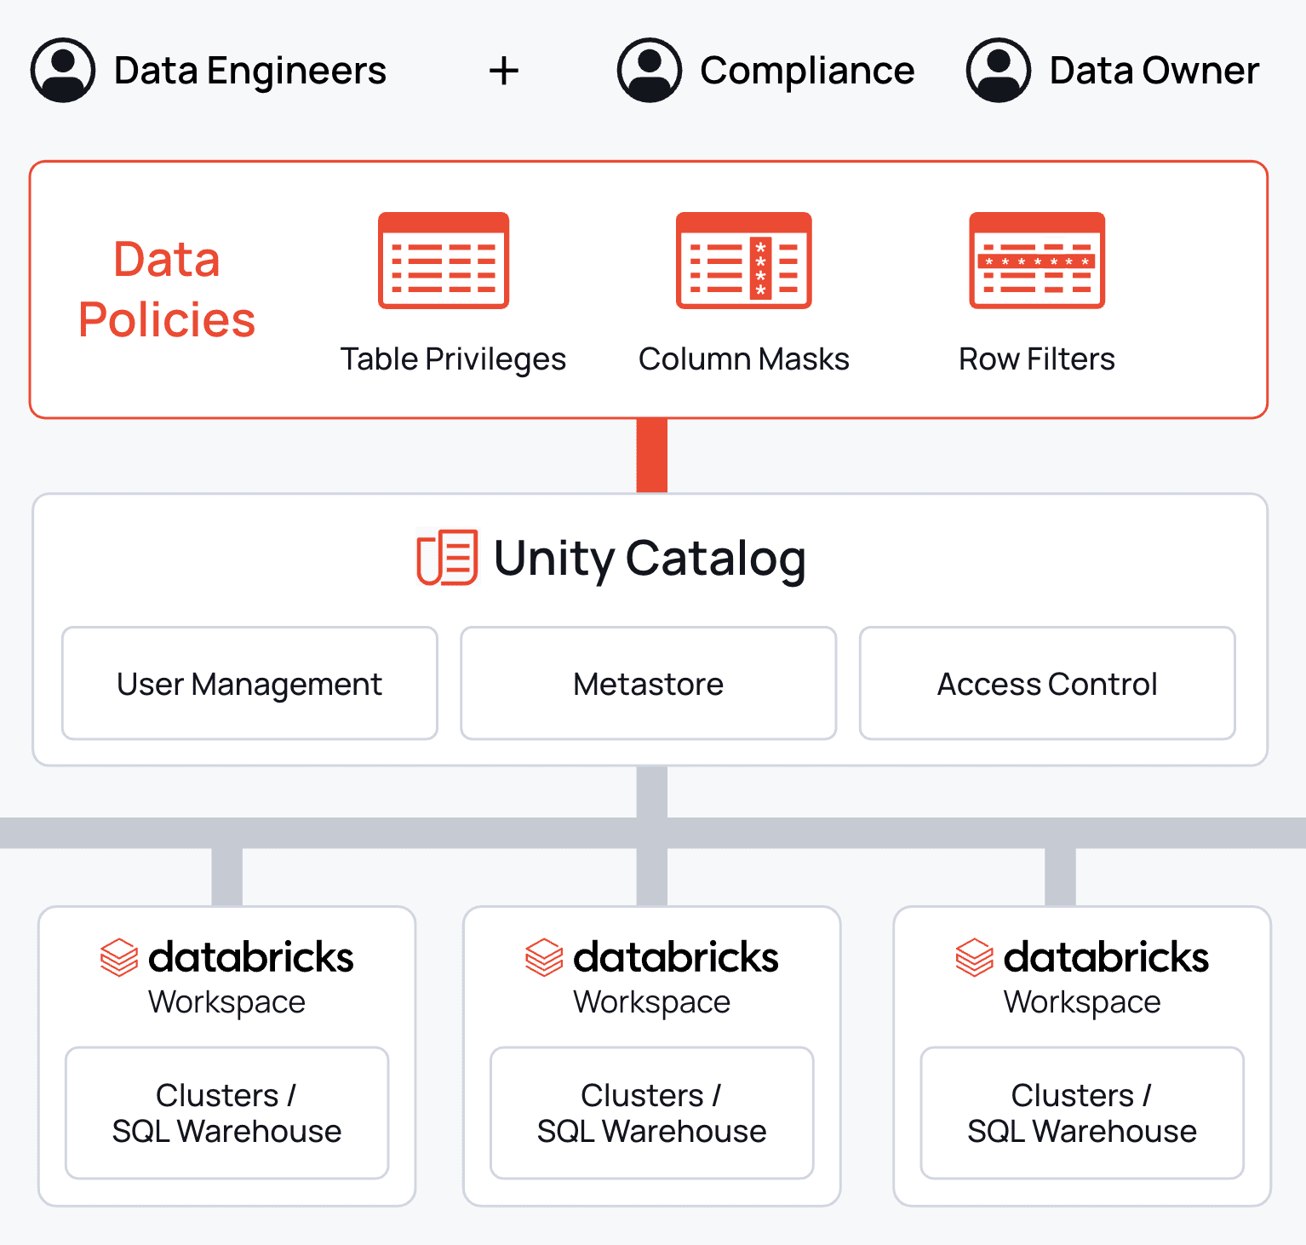
Unity Catalog Protection

Slide 112
Key Points
Column Masks
Databricks allows you to apply masking functions to table columns. These functions evaluate at query runtime, determining whether to return the original column value or a masked version based on the user’s identity.
Row Filters
You can implement row filters to ensure that queries return only rows meeting specific criteria. This is useful for restricting access to sensitive data based on user roles.
Dynamic Masking
The masking functions and filters are dynamic, meaning they are applied in real-time during query execution. This ensures that sensitive data is protected without altering the underlying data.
Unity Catalog Integration
Databricks Data Masking features are integrated with Unity Catalog, providing a unified governance solution that includes data masking, access control, and auditing.

Slide 113
Lab: Protect Your Data

Slide 114
Databricks Repos

Slide 115
Key Points
Git Integration
Databricks Repos provides native integration with popular Git providers like GitHub, GitLab, Bitbucket, and Azure DevOps. This allows you to clone remote repositories, manage branches, and perform Git operations directly within the Databricks environment.
Collaboration and Version Control
Repos enable collaborative development by allowing multiple users to work on the same project with version control. This ensures that changes are tracked, and different versions of the code can be managed efficiently.
CI/CD Integration
Databricks Repos supports continuous integration and continuous deployment (CI/CD) workflows. You can automate Git workflows using the Repos REST API, integrating your data projects into larger software operations.
Repo-Level Access Control
Repos offer fine-grained access control, allowing you to manage permissions at the repository level. This ensures that only authorized users can access and modify the code, enhancing security.

Slide 116
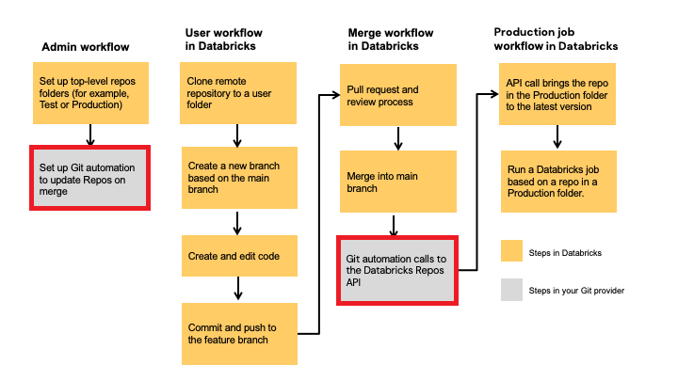
Versioning Flow

Slide 117
Lab: Version Your Code

Slide 118
Secret Scopes

Slide 119
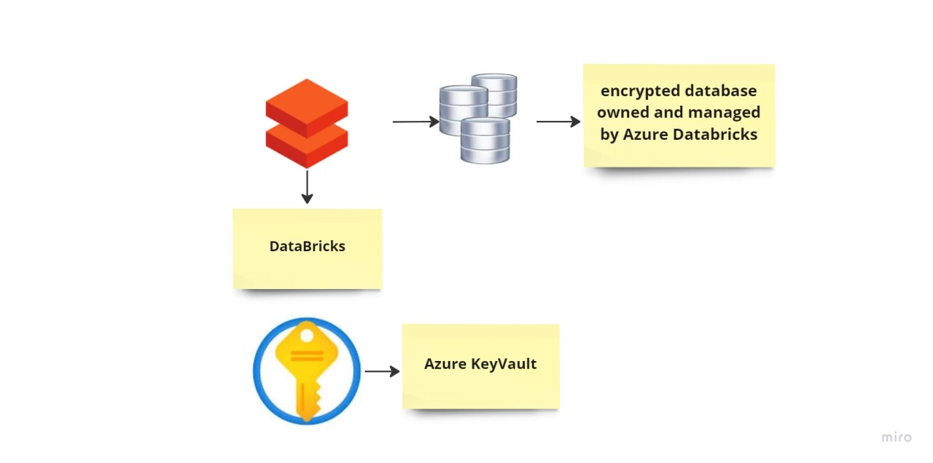
Azure Key Vault Integration

Slide 120
Key Points
Centralized Secret Management
Secret scopes allow you to manage secrets (such as database credentials, API keys, etc.) centrally within Databricks. This ensures that sensitive information is stored securely and accessed only by authorized users.
Integration with Databricks CLI and API
You can create and manage secret scopes using the Databricks CLI or the Secrets API. This flexibility allows for automation and integration into your existing workflows.
Access Control
Secret scopes support fine-grained access control through Access Control Lists (ACLs). This means you can specify which users or groups have permission to read or manage secrets within a scope.
Support for Multiple Backends
Databricks supports both Databricks-backed and Azure Key Vault-backed secret scopes. This allows you to choose the backend that best fits your security and compliance requirements.

Slide 121
Lab: Secret Your Keys

Slide 122
Spark Stream

Slide 123
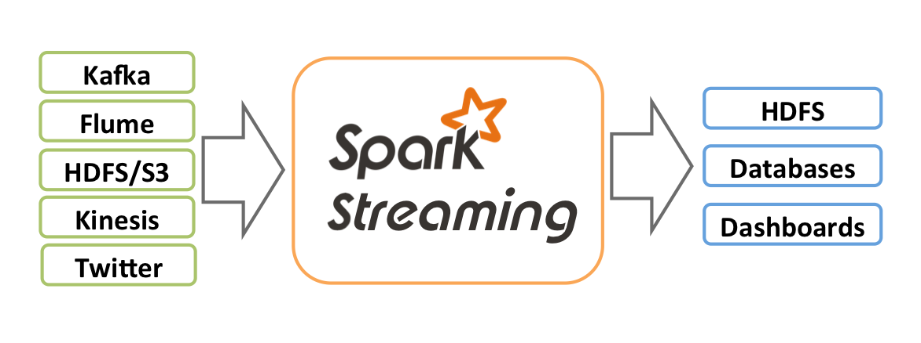
Spark Streaming

Slide 124
Key Points
Real-Time Data Processing
Databricks Spark Streaming allows for real-time data processing, enabling you to process data as it arrives. This is crucial for applications that require immediate insights and actions, such as fraud detection and real-time analytics.
Unified Batch and Streaming API
Spark Streaming uses the same API for both batch and streaming data, simplifying the development process. This means you can write your code once and run it in both batch and streaming modes.
Fault Tolerance
Spark Streaming is designed to be fault-tolerant, ensuring that your data processing continues smoothly even in the event of failures. It achieves this through features like checkpointing and state management.
Scalability
Spark Streaming can scale to handle large volumes of data, making it suitable for big data applications. It leverages the distributed computing power of Apache Spark to process data efficiently across multiple nodes.

Slide 125
Lab: Stream the Data

Slide 126
Autoloader

Slide 127
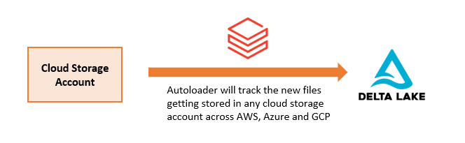
Autoloader Behavior

Slide 128
Key Points
Incremental and Efficient Data Ingestion
Autoloader can incrementally process new data files as they arrive in cloud storage, without requiring additional setup. This ensures efficient and timely data ingestion.
Scalability
It is designed to handle large-scale data ingestion, capable of processing billions of files and supporting near real-time loading of millions of files per hour.
Schema Inference and Evolution
Autoloader automatically handles schema inference and evolution, making it easier to work with diverse data formats like CSV, JSON, Avro, and more.
Fault Tolerance and Exactly-Once Processing
It provides exactly-once processing semantics by tracking metadata in a scalable key-value store, ensuring data is processed accurately even in the event of failures.

Slide 129
Lab: Automatize Your Folder

Slide 130
Monitoring & Alerting

Slide 131
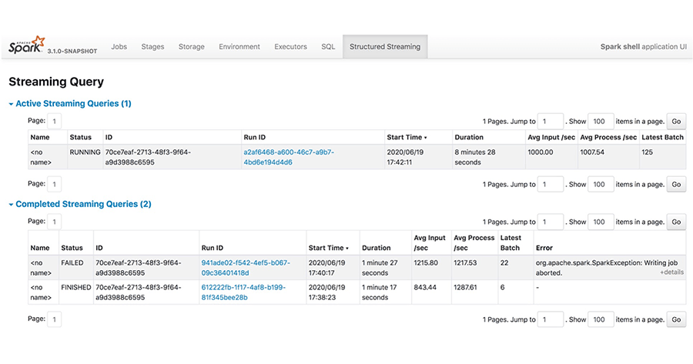
Spark UI

Slide 132
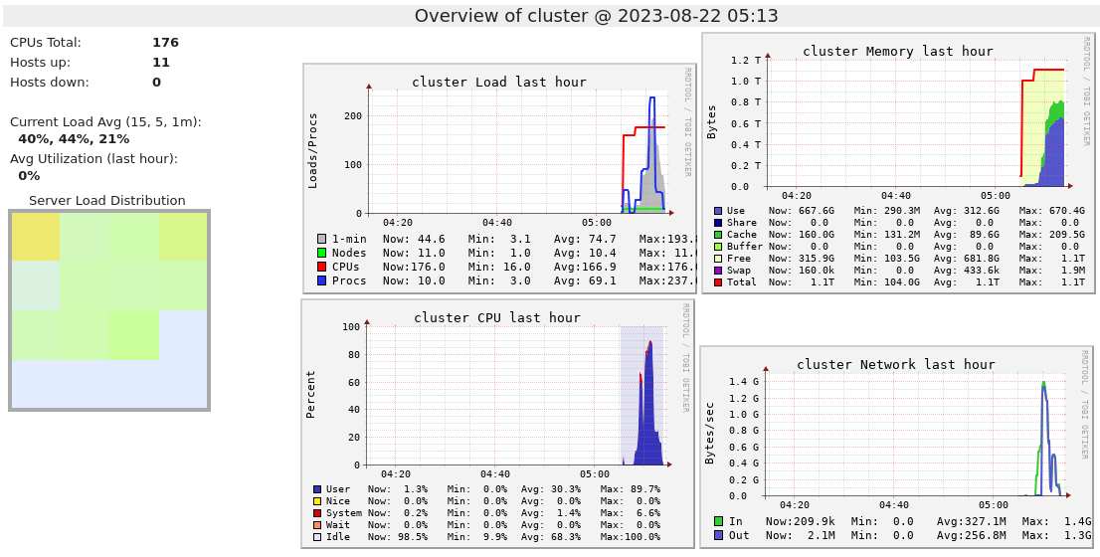
Resource Management

Slide 133
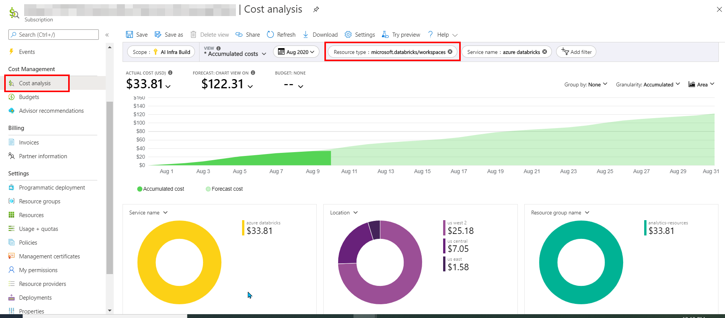
$!!!!

Slide 134
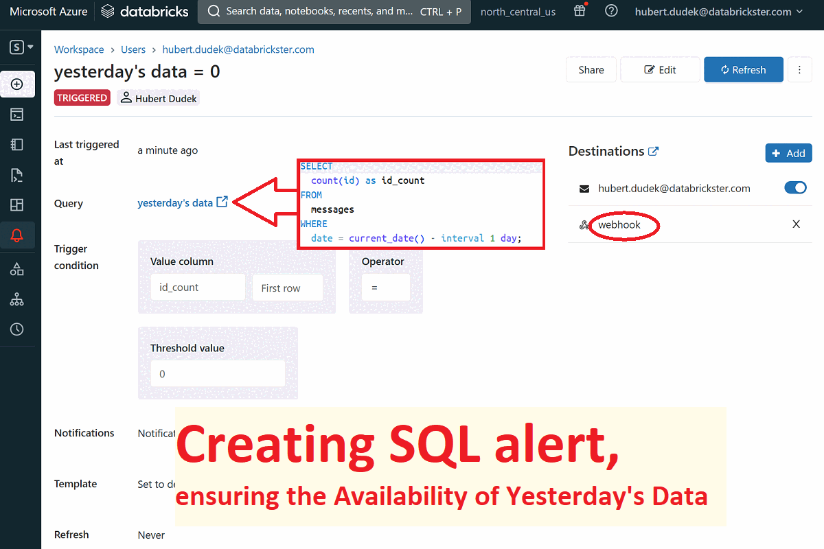
Activate the Data

Slide 135
Key Points
Real-Time Alerting
Databricks provides real-time alerting capabilities, allowing you to receive notifications when specific metrics or conditions are met. This helps in promptly identifying and addressing issues.
Comprehensive Monitoring
The platform offers extensive monitoring tools to track the performance, health, and status of your data pipelines, clusters, and jobs. This includes monitoring workload status, errors, performance bottlenecks, and resource usage.
Custom Metrics and Dashboards
You can create custom metrics and dashboards to visualize and analyze the performance of your Databricks environment. This customization helps in tailoring the monitoring to your specific needs.
Integration with External Tools
Databricks monitoring and alerting can be integrated with external tools like Slack, PagerDuty, and other webhook-compatible services. This ensures that alerts and notifications can be routed to your preferred communication channels.

Slide 136
Lab: monitoring walkthrough

Slide 137
Azure Data Factory

Slide 138
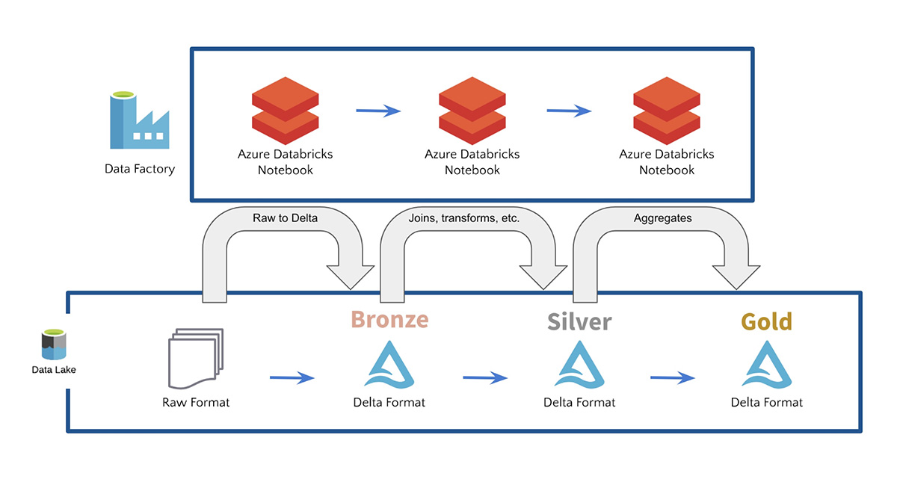
Orchestrating, again

Slide 139
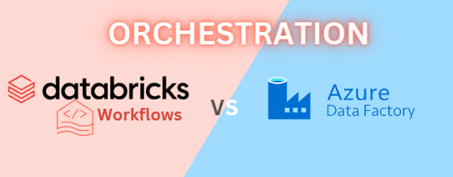
You choose

Slide 140
Lab: orchestrate with Azure Data Factory

Slide 141
Knowledge Review

Slide 142

Fundamentals Of The Databricks Lakehouse Platform

